Slide 1
Reaching the Women of Central Florida
Through upgraded Social Media Presence

Slide 2
Thanks for your time
Greetings, and thank you to President Robbie Ford, and all of the members of the Orlando Republican Women's Network (ORWN). The following information is for the purpose of informing ORWN board member's about Sai Super Software Solutions (SSSS), and what services we can provide to your organization.

Slide 3
About our company
SSSS is a Florida based company that prides itself on providing the highest quality web & IT solutions to businesses around the world. Our work stretches across Government, Private, and Non-Profit sectors. We have developed websites for many different Non - Profit organizations not only in the US, but in India, Ireland, Malaysia, Singapore, and the United Kingdom. The following link saisharan.info has examples to reflect some of our work since 2001.

Slide 4
What sets us apart
There are three things that we do at SSSS that we pride ourselves and our reputation on. First of quality of work, and the second is the building of lasting professional relationships. Building meaningful relationships allow us to better understand your needs. Not only what you are wanting today, but what your vision is for the future. Our goal is to walk with you as partners to achieve those things which are important to you as an organization. The third and most important is to known as a company that deals ethically, honestly, and with integrity. For further examples of previous work, and testimonials please check out http://saisupersol.com/work.html .

Slide 5
Finding the solution you desire
Based on conversations that I had with President Robbie Ford in July, 2013 she asked me to look at two existing websites. The first was the ORWN website. Second was that of the Northwest Orange Republican Women's Federated (NORWF) website. While not wanting it to be exactly that way it was made clear by Mrs. Ford that she desired to update both the look and functionality of the site.
In researching the new site for the ORWN we feel like we can provide a site that not only meets the immediate needs of an updated site, but provides the tools and resources to grow going forward. The site would be built on a Wordpress platform just like the NORWF site is. Currently 28% of all websites worldwide are built on Wordpress. Through this site we can upgrade your ability to communicate and get your message out with the following upgrades.

Slide 6
Benefits of the new website
Connection to social media. (Facebook, Twitter, Linked-in, etc.)
An animated, and interactive site.
Ability to make connect to a database.
( Donations, Reservations, Contacts)
Improved Search Engine Optimization.
Improved Storage.
Ability to add videos from or about upcoming events.
Drop down displays.
Ability to Blog, and add Monthly Newsletters.

Slide 7
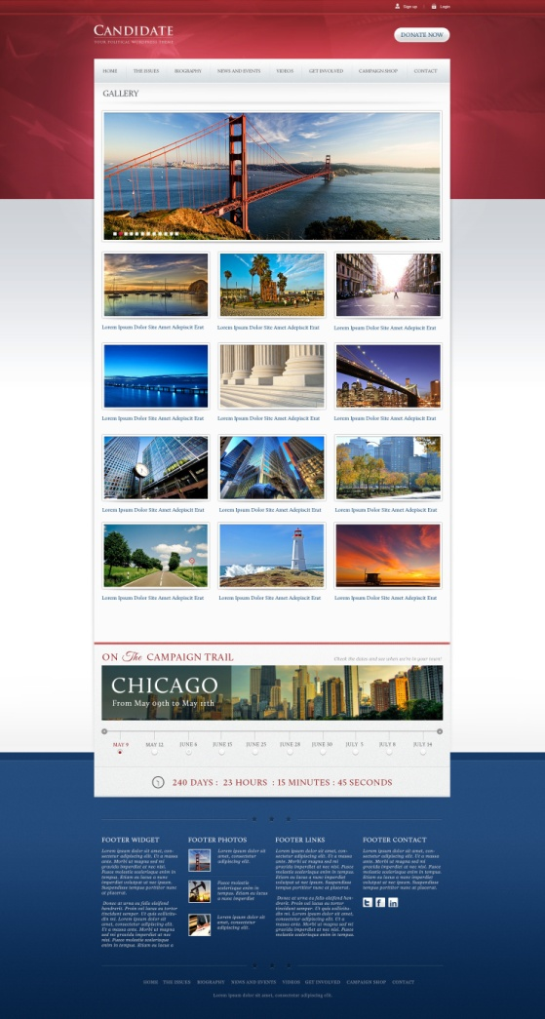
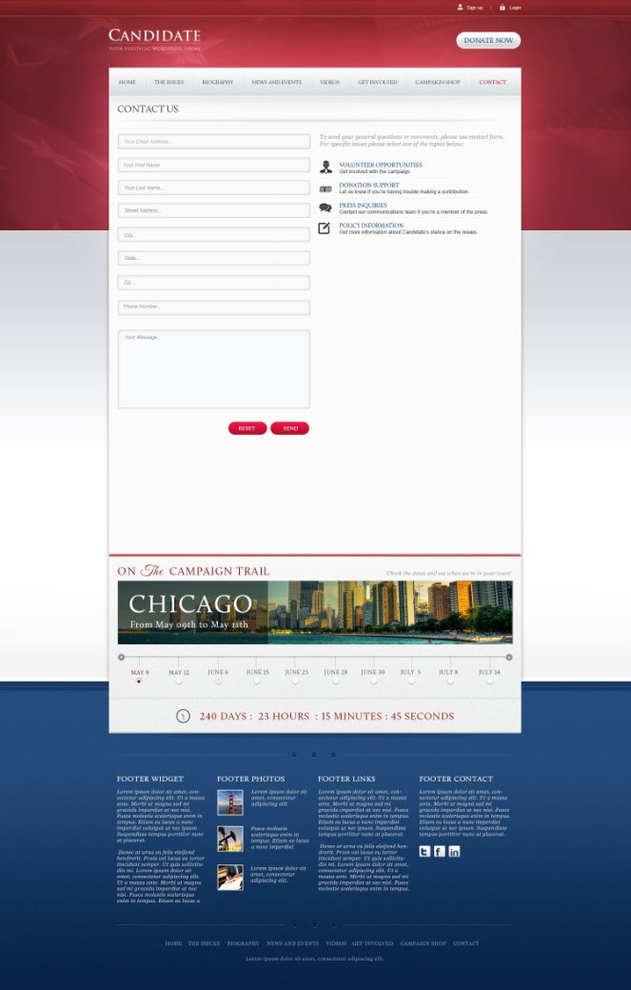
Concept samples

